Slide 1

MES Program 2020

Slide 2



CCNOAI Experience

Slide 3
CCNOAI EXPERIENCE AND DUTIES
Startup Tech company specializing in Artificial Intelligence
Cloud Cyber Networks Operations Artificial Intelligence
Lead on automating data flow and data governance
Website development
User validation testing

Slide 4
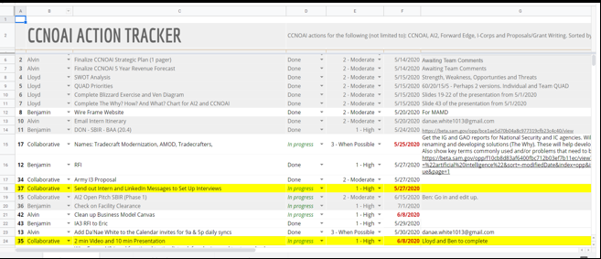
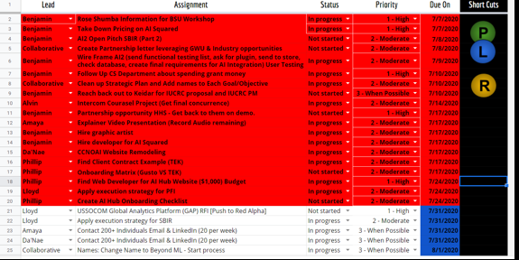
BEFORE VS. AFTER DAILY TRACKER
https://docs.google.com/spreadsheets/d/113qfgBqHs_1qD94whiJCVEPIvIwpTOaiJJjj1Vv8CGQ/edit#gid=922331350

Slide 5
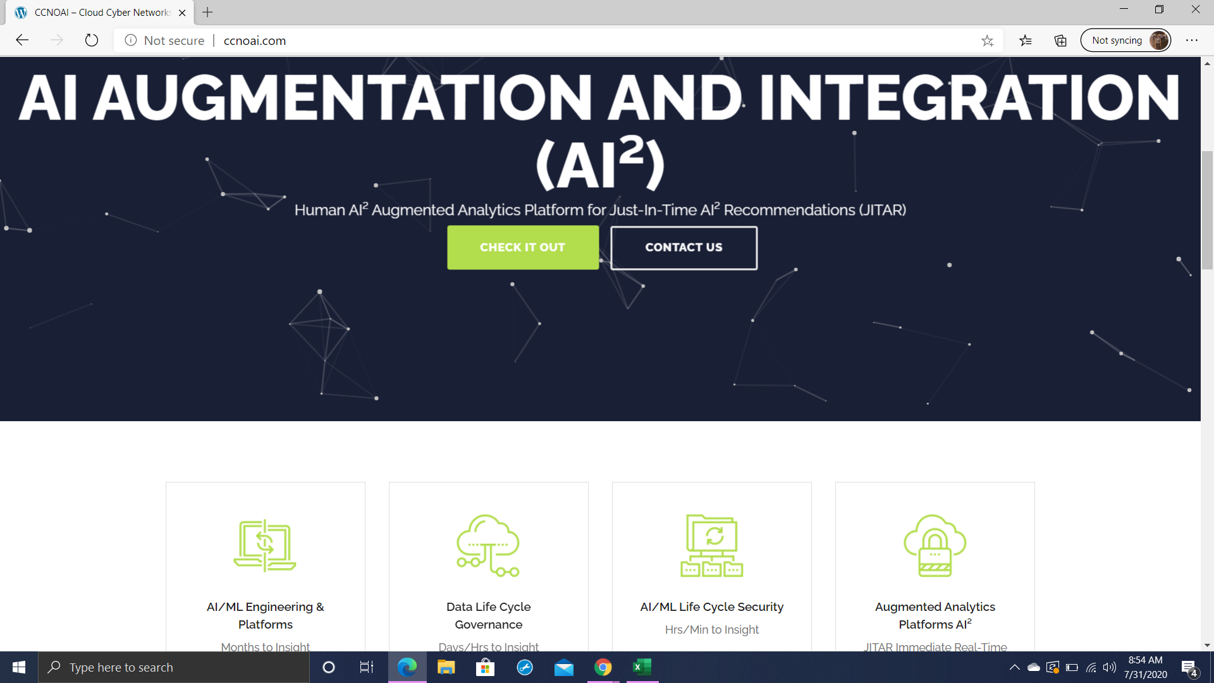
CCNOAI WEBSITE

Slide 6
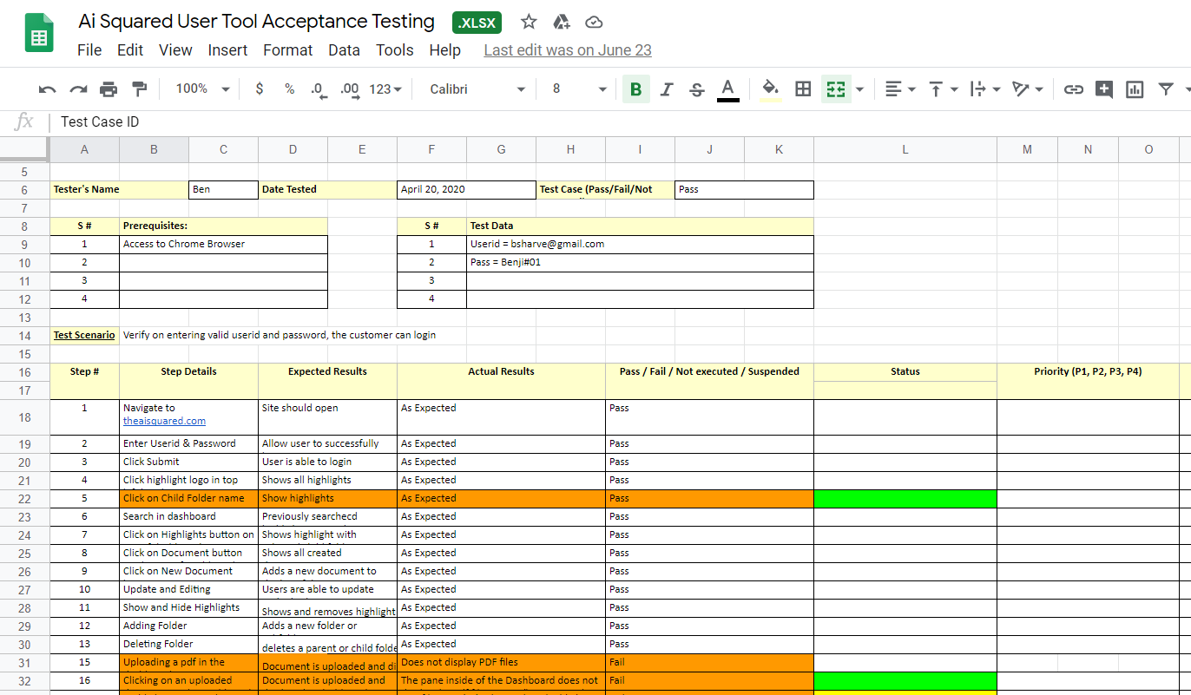
USER TESTING OF COMPANY’S TOOL

Slide 7
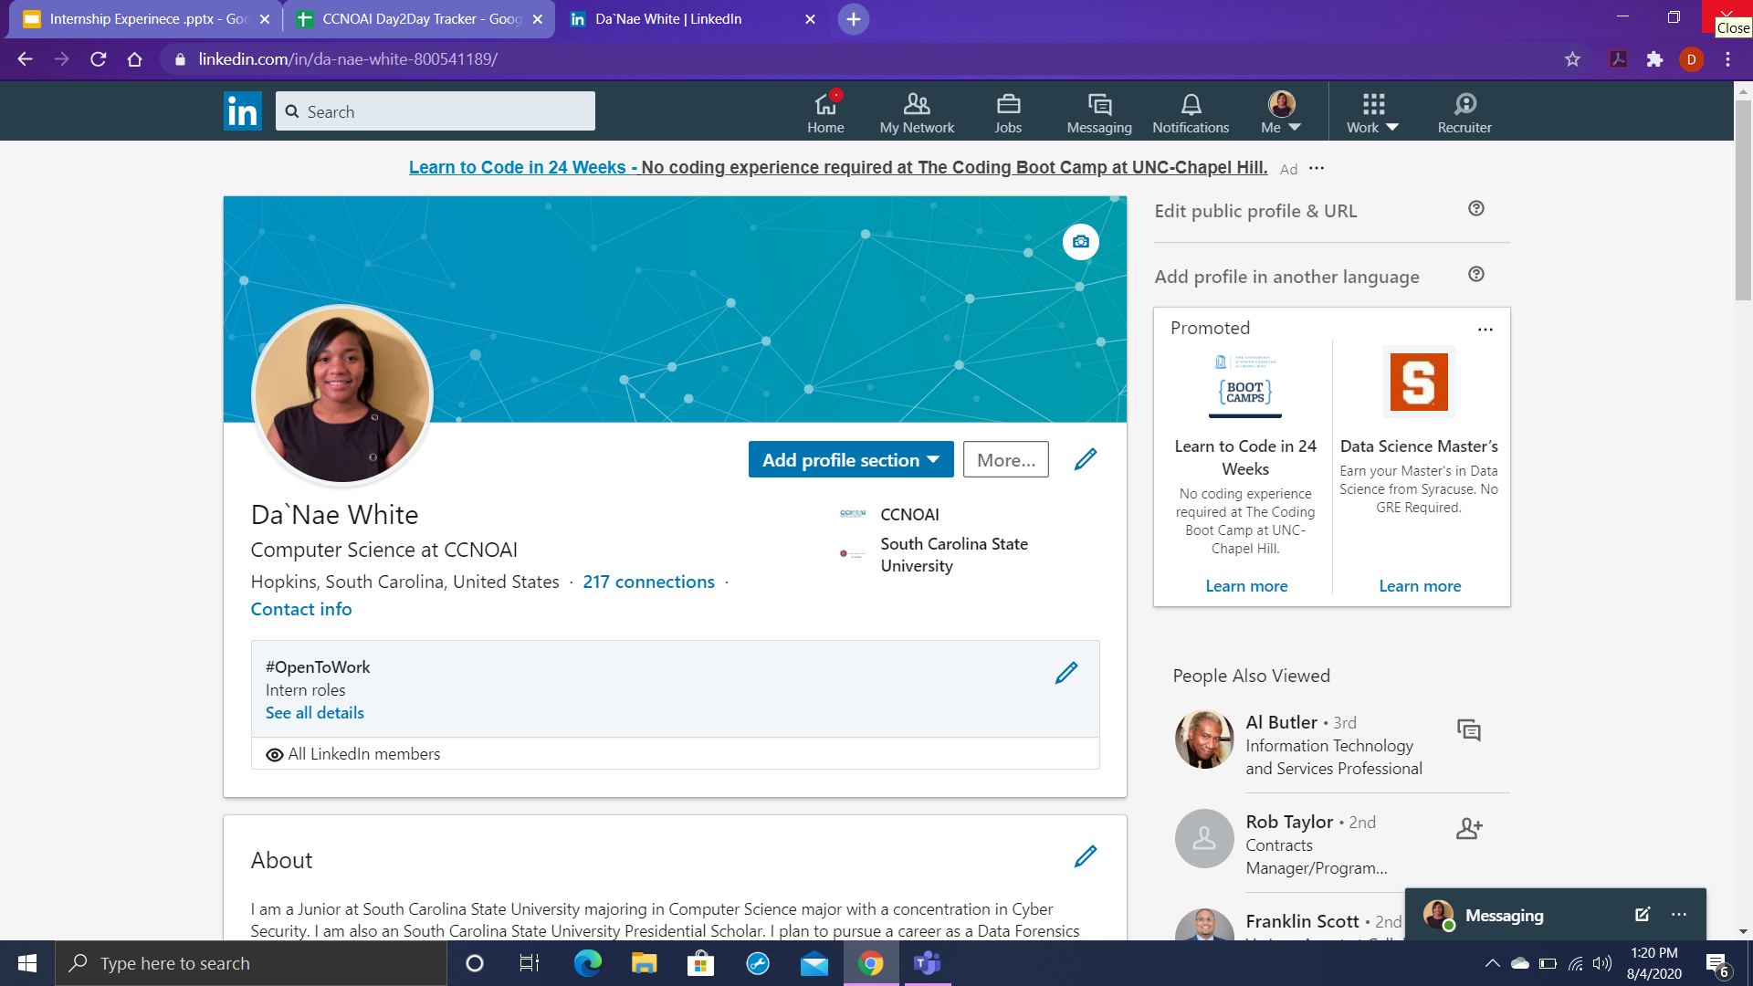
LINKEDIN MAKEOVER
Before interning with CCNOAI:
Had a “ghost profile”
Only having 7 connections
No resume and cover letter

Slide 8
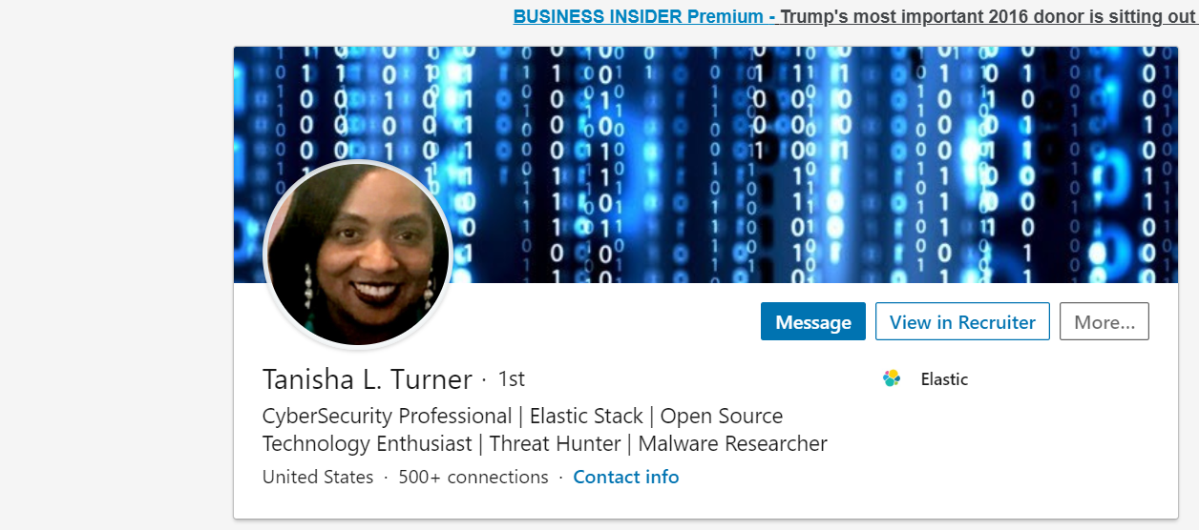
TANISHA L. TURNER
“Stay focused and remain positive and don’t let adversities hinder you from accomplishing and achieving your goals and aspirations You’re not defined and validated by other people’s opinions.”

Slide 9
GOALS AND ASPIRATIONS
Completing my CompTIA Security+ and Ethical Hacking certifications by the end of the year
Remain on the President’s List for the remaining of my time at SC State University
Have a successful research experience
Continue to grow and maintain LinkedIn connections

Slide 10

ACKNOWLEDGMENTS
Pre-College University Staff
Department of Energy
CCNOAI Mentors

Slide 11
Any Questions?

